Slide 1
Richardson Maturity Model
Course Code: CSC 4164
Course Title: ADVANCED PROGRAMMING WITH .NET
Dept. of Computer Science
Faculty of Science and Technology
Lecture No: | 12 | Week No: | 09 | Semester:
Lecturer: | Victor Stany Rozario, stany@aiub.edu

Slide 2
Lecture Outline
Different Levels of API
Richardson Maturity Model

Slide 3
Richardson Maturity Model
Leonard Richardson analyzed a hundred different web service designs and divided them in four categories based on how much they are REST compliant. This model of division of REST services to identify their maturity level – is called Richardson Maturity Model.
Richardson used three factors to decide the maturity of a service i.e. URI, HTTP
Methods and HATEOAS(Hypermedia). The more a service employs these technologies – more mature it shall be considered.

Slide 4
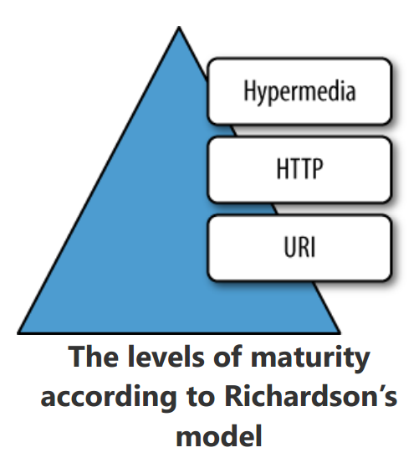
Richardson Maturity Model

Slide 5
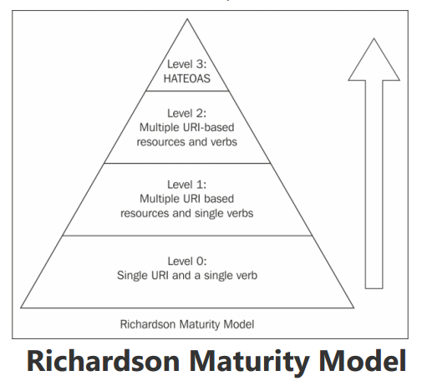
Richardson Maturity Model
In this analysis, Richardson described
these maturity levels as below:
Level Zero
Level One
Level Two
Level Three

Slide 6
Level Zero
Level zero of maturity do not make use of any of URI, HTTP Methods and HATEOAS capabilities.
These services have a single URI and use a single HTTP method (typically POST). For example, most Web Services (WS-*)-based services use a single URI to identify an endpoint, and HTTP POST to transfer SOAP-based payloads, effectively ignoring the rest of the HTTP verbs.
Similarly, XML-RPC based services which send data as Plain Old XML (POX). These are the most primitive way of building SOA applications with a single POST method and using XML to communicate between services.

Slide 7
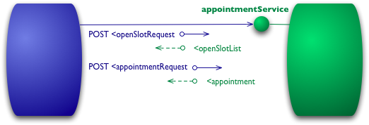
Level Zero
The starting point for the model is using HTTP as a transport system for remote interactions, but without using any of the mechanisms of the web. Essentially what you are doing here is using HTTP as a tunneling mechanism for your own remote interaction mechanism, usually based on Remote Procedure Invocation.

Slide 8
Level Zero
Let's assume I want to book an appointment with my doctor. My appointment software first needs to know what open slots my doctor has on a given date, so it makes a request of the hospital appointment system to obtain that information. In a level 0 scenario, the hospital will expose a service endpoint at some URI. I then post to that endpoint a document containing the details of my request.
POST /appointmentService HTTP/1.1
[various other headers]
<openSlotRequest date = "2010-01-04" doctor = "mjones"/>

Slide 9
Level Zero
The server then will return a document giving me this information.
I'm using XML here for the example, but the content can actually be anything: JSON, YAML, key-value pairs, or any custom format.
HTTP/1.1 200 OK
[various headers]
<openSlotList>
<slot start = "1400" end = "1450">
<doctor id = "mjones"/>
</slot>
<slot start = "1600" end = "1650">
<doctor id = "mjones"/>
</slot>
</openSlotList>

Slide 10
Level Zero
My next step is to book an appointment, which I can again do by posting a document to the endpoint.
POST /appointmentService HTTP/1.1
[various other headers]
<appointmentRequest>
<slot doctor = "mjones" start = "1400" end = "1450"/>
<patient id = "jsmith"/>
</appointmentRequest>

Slide 11
Level Zero
If all is well I get a response saying my appointment is booked.
HTTP/1.1 200 OK
[various headers]
<appointment>
<slot doctor = "mjones" start = "1400" end = "1450"/>
<patient id = "jsmith"/>
</appointment>

Slide 12
Level Zero
If there is a problem, say someone else got in before me, then I'll get some kind of error message in the reply body.
HTTP/1.1 200 OK
[various headers]
<appointmentRequestFailure>
<slot doctor = "mjones" start = "1400" end = "1450"/>
<patient id = "jsmith"/>
<reason>Slot not available</reason>
</appointmentRequestFailure>
So far this is a straightforward RPC style system. It's simple as it's just slinging plain old XML (POX) back and forth. If you use SOAP or XML-RPC it's basically the same mechanism, the only difference is that you wrap the XML messages in some kind of envelope.

Slide 13
Level One
Level one of maturity makes use of URIs out of URI, HTTP Methods and HATEOAS.
These services employ many URIs but only a single HTTP verb – generally HTTP POST. They give each individual resource in their universe a URI. Every resource is separately identified by a unique URI – and that make them better than level zero.

Slide 14
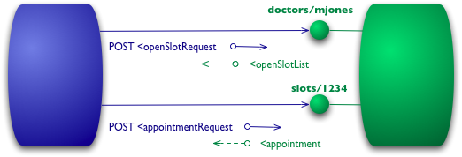
Level One
The first step towards the Glory of Rest in the RMM is to introduce resources. So now rather than making all our requests to a singular service endpoint, we now start talking to individual resources.

Slide 15
Level One
So with our initial query, we might have a resource for given doctor.
POST /doctors/mjones HTTP/1.1
[various other headers]
<openSlotRequest date = "2010-01-04"/>
The reply carries the same basic information, but each slot is now a resource that can be addressed individually.
HTTP/1.1 200 OK
[various headers]
<openSlotList>
<slot id="1234" doctor="mjones" start= "1400" end= "1450"/>
<slot id="5678" doctor="mjones" start= "1600" end= "1650"/>
</openSlotList>

Slide 16
Level One
With specific resources booking an appointment means posting to a particular slot.
POST /slots/1234 HTTP/1.1
[various other headers]
<appointmentRequest>
<patient id = "jsmith"/>
</appointmentRequest>
If all goes well I get a similar reply to before.
HTTP/1.1 200 OK
[various headers]
<appointment>
<slot id= "1234" doctor= "mjones" start= "1400" end= "1450"/>
<patient id = "jsmith"/>
</appointment>

Slide 17
Level One
The difference now is that if anyone needs to do anything about the appointment, like book some tests, they first get hold of the appointment resource, which might have a URI like http://royalhope.nhs.uk/slots/1234/appointment and post to that resource.
To an object guy like me this is like the notion of object identity. Rather than calling some function in the ether and passing arguments, we call a method on one particular object providing arguments for the other information.

Slide 18
Level Two
Level two of maturity makes use of URIs and HTTPout of URI, HTTP Methods and HATEOAS.
Level two services host numerous URI-addressable resources. Such services support several of the HTTP verbs on each exposed resource – Create, Read, Update and Delete (CRUD) services.
Here the state of resources, typically representing business entities, can be manipulated over the network.
Here service designer expect people to put some effort into mastering the APIs – generally by reading supplied documentation.
Level 2 is good use case of REST principles, which advocate using different verbs based on the HTTP request methods and the system can have multiple resources.

Slide 19
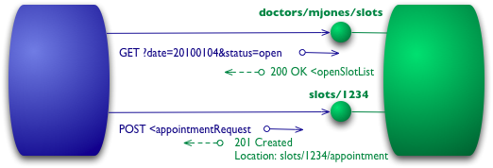
Level Two
I've used HTTP POST verbs for all my interactions here in level 0 and 1, but some people use GETs instead or in addition. At these levels it doesn't make much difference, they are both being used as tunneling mechanisms allowing you to tunnel your interactions through HTTP. Level 2 moves away from this, using the HTTP verbs as closely as possible to how they are used in HTTP itself.

Slide 20
Level Two
For our the list of slots, this means we want to use GET.
GET /doctors/mjones/slots?date=20100104&status=open HTTP/1.1
Host: royalhope.nhs.uk
The reply is the same as it would have been with the POST
HTTP/1.1 200 OK
[various headers]
<openSlotList>
<slot id="1234" doctor="mjones" start="1400" end="1450"/>
<slot id="5678" doctor="mjones" start="1600" end="1650"/>
</openSlotList>

Slide 21
Level Two
At Level 2, the use of GET for a request like this is crucial. HTTP defines GET as a safe operation, that is it doesn't make any significant changes to the state of anything. This allows us to invoke GETs safely any number of times in any order and get the same results each time. An important consequence of this is that it allows any participant in the routing of requests to use caching, which is a key element in making the web perform as well as it does. HTTP includes various measures to support caching, which can be used by all participants in the communication. By following the rules of HTTP we're able to take advantage of that capability.

Slide 22
Level Two
To book an appointment we need an HTTP verb that does change state, a POST or a PUT. I'll use the same POST that I did earlier.
POST /slots/1234 HTTP/1.1
[various other headers]
<appointmentRequest>
<patient id = "jsmith"/>
</appointmentRequest>
The trade-offs between using POST and PUT here are more than I want to go into here, maybe I'll do a separate article on them some day. But I do want to point out that some people incorrectly make a correspondence between POST/PUT and create/update. The choice between them is rather different to that.

Slide 23
Level Two
Even if I use the same post as level 1, there's another significant difference in how the remote service responds. If all goes well, the service replies with a response code of 201 to indicate that there's a new resource in the world.
HTTP/1.1 201 Created
Location: slots/1234/appointment
[various headers]
<appointment>
<slot id="1234" doctor="mjones" start="1400" end="1450"/>
<patient id = "jsmith"/>
</appointment>

Slide 24
Level Two
The 201 response includes a location attribute with a URI that the client can use to GET the current state of that resource in the future. The response here also includes a representation of that resource to save the client an extra call right now.
There is another difference if something goes wrong, such as someone else booking the session.
HTTP/1.1 409 Conflict
[various headers]
<openSlotList>
<slot id="5678" doctor= "mjones" start="1600" end="1650"/>
</openSlotList>
The important part of this response is the use of an HTTP response code to indicate something has gone wrong. In this case a 409 seems a good choice to indicate that someone else has already updated the resource in an incompatible way. Rather than using a return code of 200 but including an error response, at level 2 we explicitly use some kind of error response like this. It's up to the protocol designer to decide what codes to use, but there should be a non-2xx response if an error crops up. Level 2 introduces using HTTP verbs and HTTP response codes.

Slide 25
Level Two
There is an inconsistency creeping in here. REST advocates talk about using all the HTTP verbs. They also justify their approach by saying that REST is attempting to learn from the practical success of the web. But the world-wide web doesn't use PUT or DELETE much in practice. There are sensible reasons for using PUT and DELETE more, but the existence proof of the web isn't one of them.
The key elements that are supported by the existence of the web are the strong separation between safe (eg GET) and non-safe operations, together with using status codes to help communicate the kinds of errors you run into.

Slide 26
Level Three
Level three of maturity makes use of all three i.e. URIs and HTTP and HATEOAS.
This is the most mature level of Richardson’s model which encourages easy discoverability and makes it easy for the responses to be self-explanatory by using HATEOAS.
The service leads consumers through a trail of resources, causing application state transitions as a result.

Slide 27
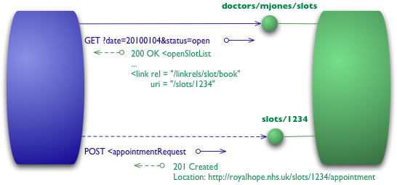
Level Three
The final level introduces something that you often hear referred to under the ugly acronym of HATEOAS (Hypertext As The Engine Of Application State). It addresses the question of how to get from a list open slots to knowing what to do to book an appointment.

Slide 28
Level Three
We begin with the same initial GET that we sent in level 2
GET /doctors/mjones/slots?date=20100104&status=open HTTP/1.1
Host: royalhope.nhs.uk
But the response has a new element
HTTP/1.1 200 OK
[various headers]
<openSlotList>
<slot id = "1234" doctor = "mjones" start = "1400" end = "1450">
<link rel = "/linkrels/slot/book" uri = "/slots/1234"/>
</slot>
<slot id = "5678" doctor = "mjones" start = "1600" end = "1650">
<link rel = "/linkrels/slot/book" uri = "/slots/5678"/>
</slot>
</openSlotList>

Slide 29
Level Three
Each slot now has a link element which contains a URI to tell us how to book an appointment.
The point of hypermedia controls is that they tell us what we can do next, and the URI of the resource we need to manipulate to do it. Rather than us having to know where to post our appointment request, the hypermedia controls in the response tell us how to do it.
The POST would again copy that of level 2
POST /slots/1234 HTTP/1.1
[various other headers]
<appointmentRequest>
<patient id = "jsmith"/>
</appointmentRequest>

Slide 30
Level Three
And the reply contains a number of hypermedia controls for different things to do next.
HTTP/1.1 201 Created
Location: http://royalhope.nhs.uk/slots/1234/appointment
[various headers]

Slide 31
Level Three
<appointment>
<slot id="1234" doctor="mjones" start="1400" end="1450"/>
<patient id = "jsmith"/>
<link rel = "/linkrels/appointment/cancel"
uri = "/slots/1234/appointment"/>
<link rel = "/linkrels/appointment/addTest"
uri = "/slots/1234/appointment/tests"/>
<link rel = "self"
uri = "/slots/1234/appointment"/>
<link rel = "/linkrels/appointment/changeTime"
uri = "/doctors/mjones/slots?date=20100104&status=open"/>
<link rel = "/linkrels/appointment/updateContactInfo"
uri = "/patients/jsmith/contactInfo"/>
<link rel = "/linkrels/help"
uri = "/help/appointment"/>
</appointment>

Slide 32
Level Three
One obvious benefit of hypermedia controls is that it allows the server to change its URI scheme without breaking clients. As long as clients look up the "addTest" link URI then the server team can juggle all URIs other than the initial entry points.
A further benefit is that it helps client developers explore the protocol. The links give client developers a hint as to what may be possible next. It doesn't give all the information: both the "self" and "cancel" controls point to the same URI - they need to figure out that one is a GET and the other a DELETE. But at least it gives them a starting point as to what to think about for more information and to look for a similar URI in the protocol documentation.

Slide 33
Level Three
Similarly it allows the server team to advertise new capabilities by putting new links in the responses. If the client developers are keeping an eye out for unknown links these links can be a trigger for further exploration.
There's no absolute standard as to how to represent hypermedia controls. What I've done here is to use the current recommendations of the REST in Practice team, which is to follow ATOM (RFC 4287) I use a <link> element with a uri attribute for the target URI and a rel attribute for to describe the kind of relationship. A well known relationship (such as self for a reference to the element itself) is bare, any specific to that server is a fully qualified URI. ATOM states that the definition for well-known linkrels is the Registry of Link Relations . As I write these are confined to what's done by ATOM, which is generally seen as a leader in level 3 restfulness.

Slide 34
Books
Pro ASP.NET Web API: HTTP Web Services in ASP.NET -by Tugberk Ugurlu, Alexander Zeitler, Ali Kheyrollahi
Programming ASP .Net MVC 5 – by Nimit Joshi

Slide 35
References
https://www.tutorialsteacher.com
https://docs.microsoft.com/en-us/aspnet/web-api

